Slide 1
ICT Entrepreneurship Session 3.1 – Technology
Wagenaar, Gerard
Assistant Professor

Slide 2
Position
The Product Plan contains a functional and architectural description of your product
It so far has not made any technological choices
However, in the road to a prototype / MVP, they have to be made

Slide 3
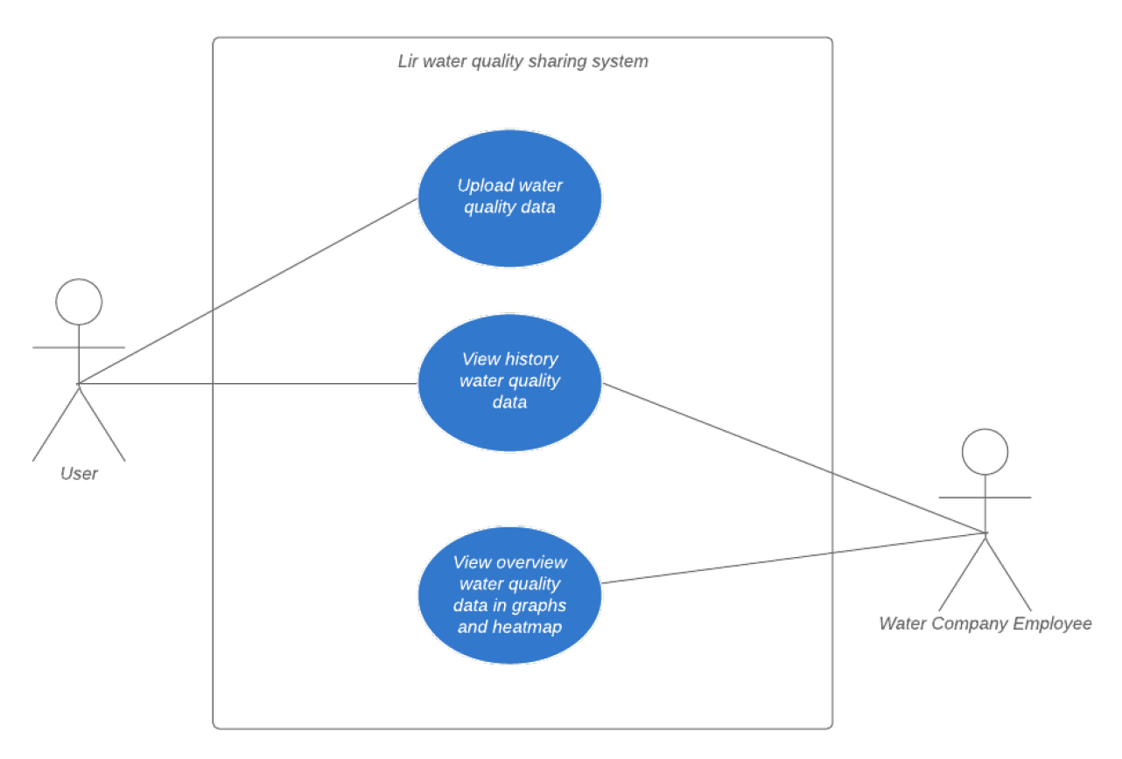
Functional Description (Example)
ES 2: When my customers measure water quality, I want them to have a hassle-free experience, so that they will be willing repeat it.
US 2.1: As a customer, I want the measurement procedure to be as easy as possible so that I don't get irritated by the procedure.
US 2.2: As a water company, I want my customers to be able to measure their water quality usine one single app.
US 2.3: As a customer, I want the required input I need to give to be step-by-step, so it is easier to understand how I need to provide my input.

Slide 4
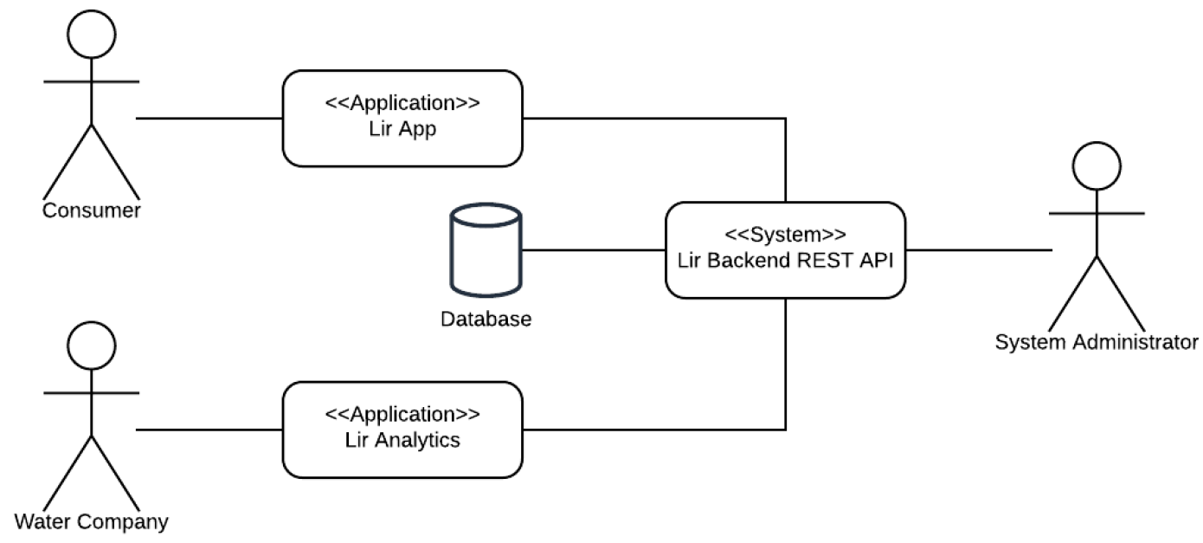
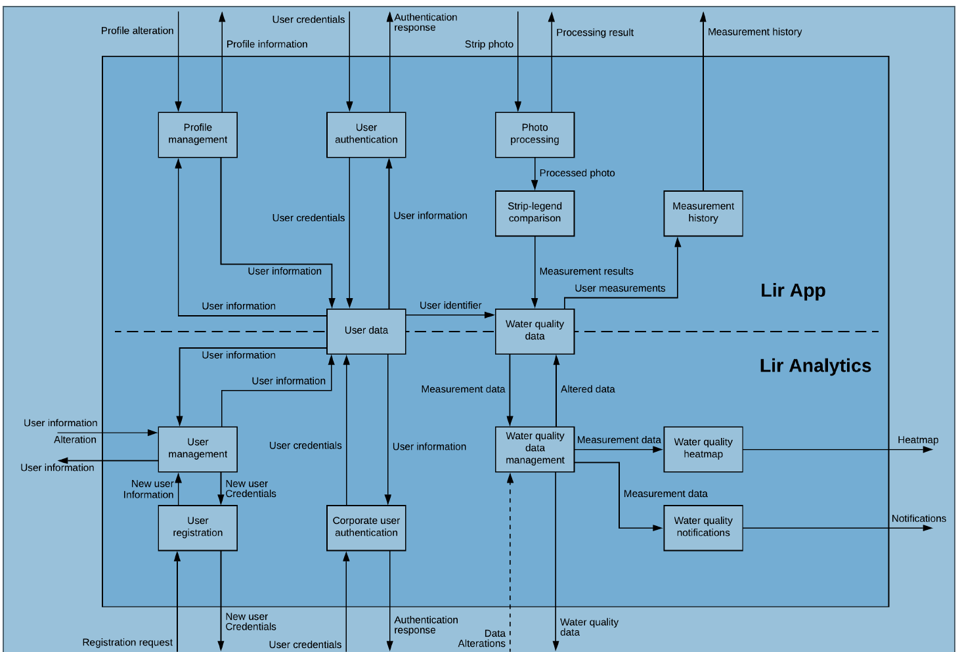
Architectural Description (Example)

Slide 5
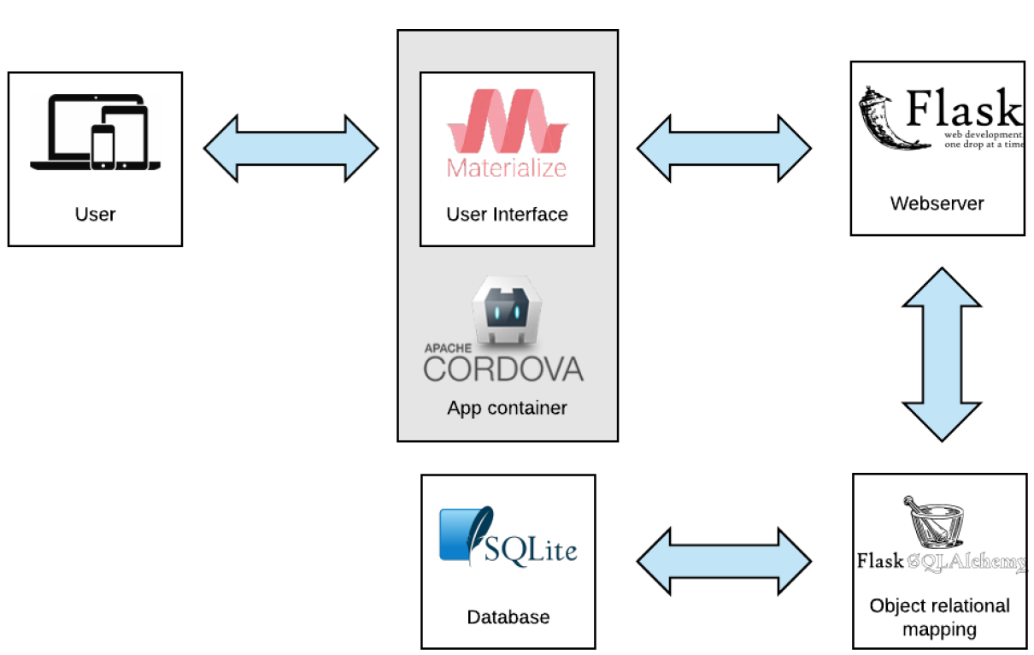
Technology & Tools: Example

